Slide 1
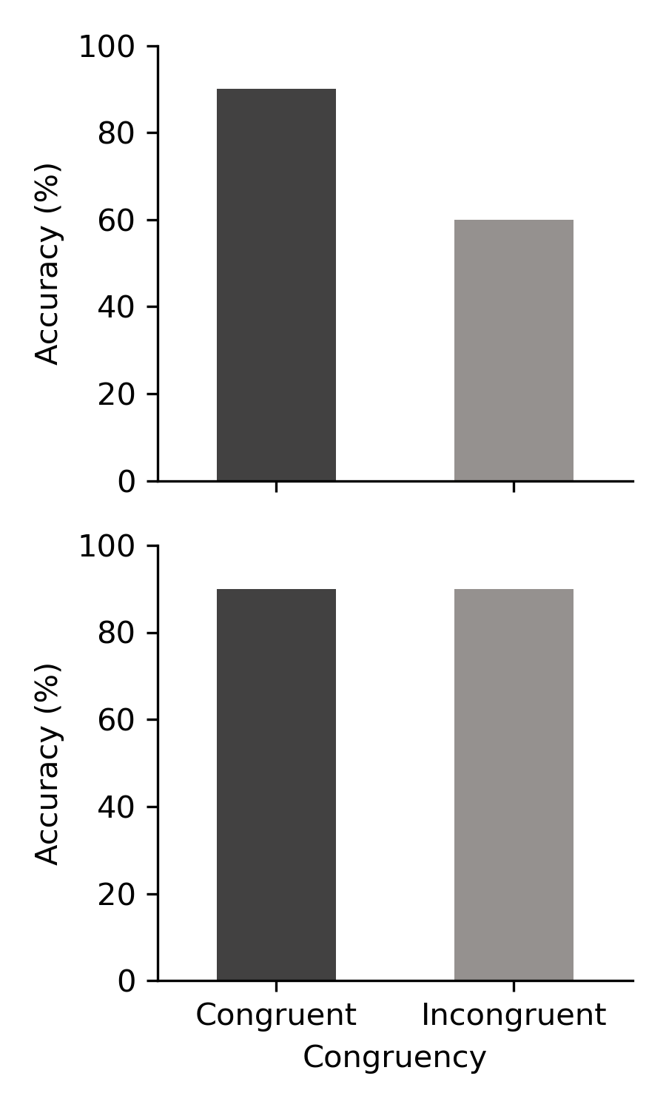
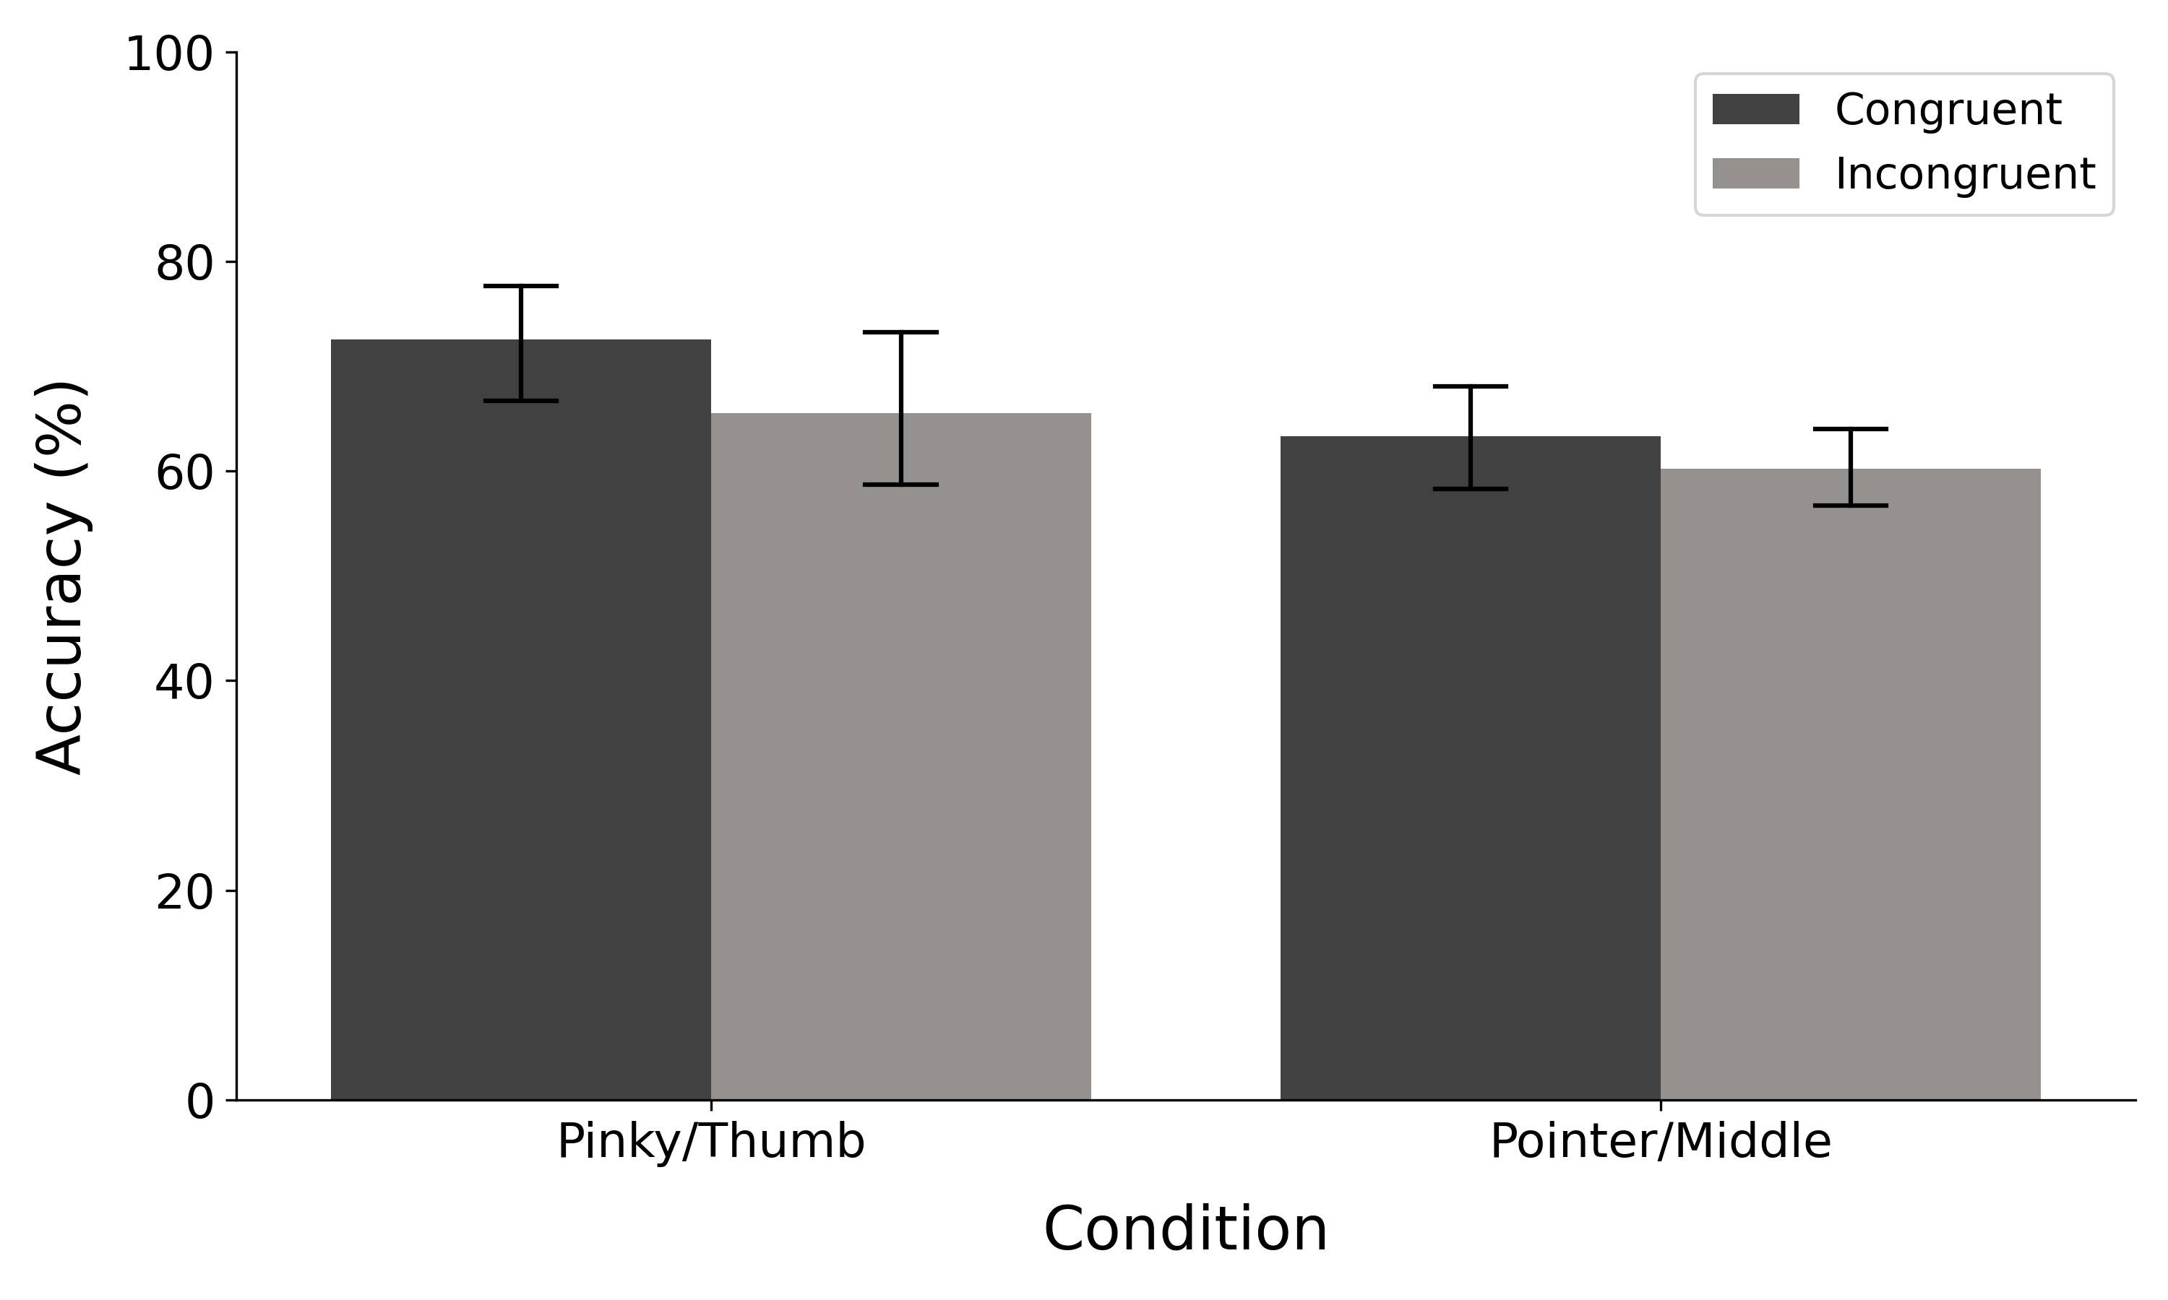
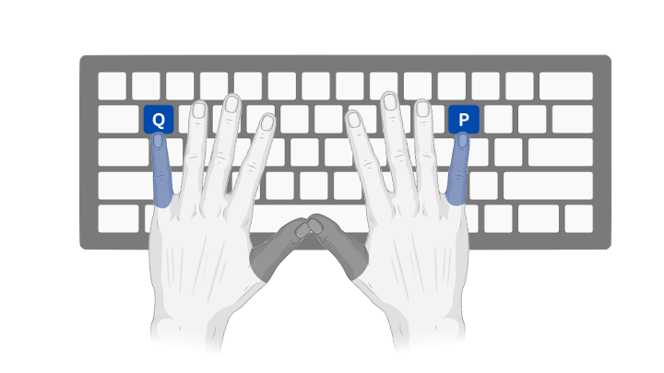


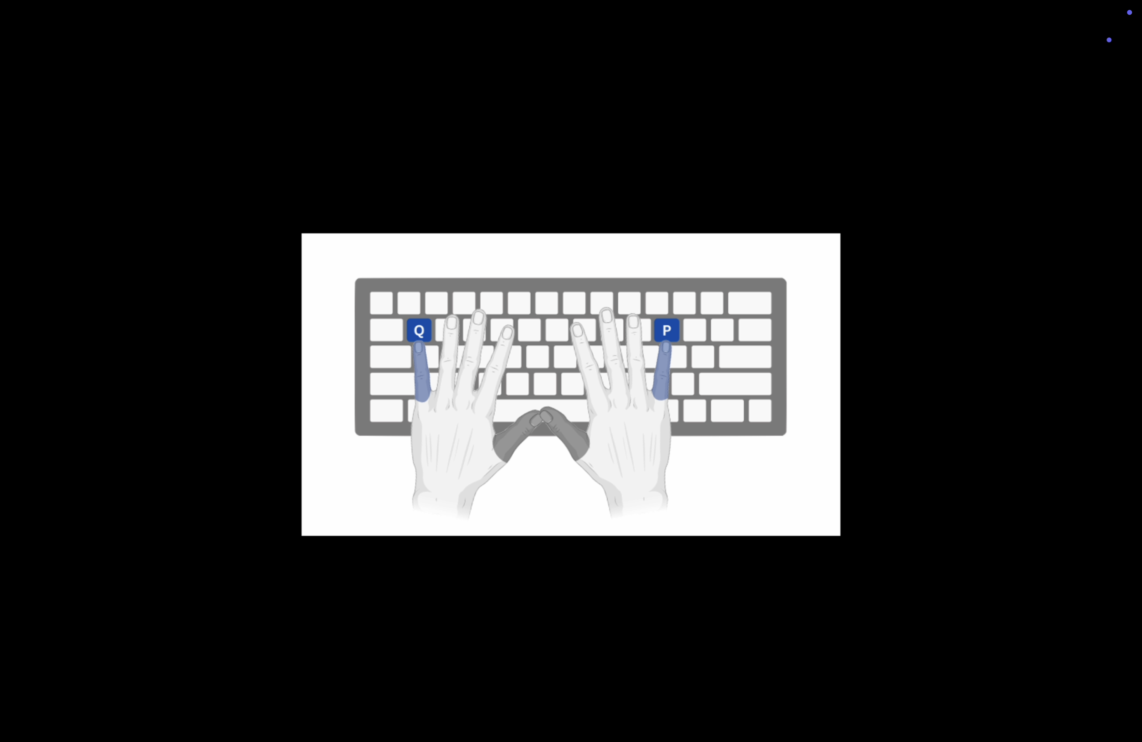
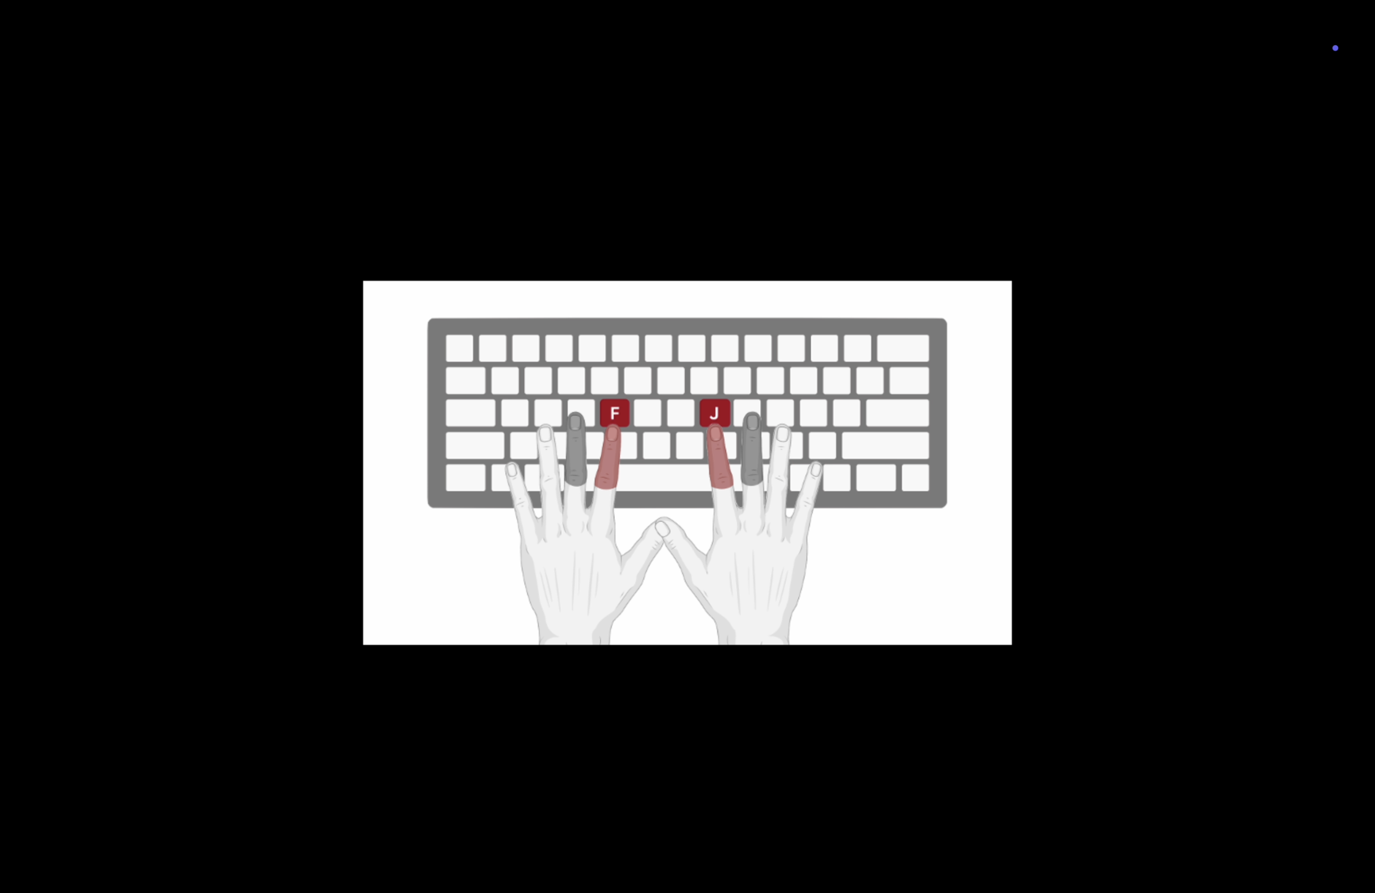








Category Learning during Task Switching
Kayla Rail¹, Saakshi Maneyalil² and Dr. Matthew Crossley²
¹ Faculty of Medicine and Health Sciences, Macquarie University, Sydney, Australia. ² School of Psychological Sciences.
INTRODUCTION
Category learning can have serious consequences (e.g. Is this berry poisonous?)
Procedural category learning is where categories are learned by forming stimulus-response associations through direct experience^{1, 2}
Under single-task conditions, prior research suggests that these associations are linked to motor goals (e.g., pressing a key on the right) and not to motor effectors (e.g., pressing with a specific finger) ^{1, 2}
During task-switching, it is unknown whether these associations are linked to motor goals or to motor effectors. ³
RESULTS
Sample Text Column 1
Motor Goal Prediction
EXPERIMENTAL RESULTS
AIMS
Determine whether procedural category learning during task switching task is driven by the formation of associations between:
Stimuli and motor goals (e.g., pressing a key on the right)
Stimuli and motor effectors (e.g., pressing with a specific finger)
Motor Effector Prediction
METHODS
Sample Text Column 1w
No difference between congruency conditions is strong evidence for motor goals
However, power is low due to small sample size
+
Used a category learning task known to recruits procedural learning
2 x 2 design: Response congruency (congruent vs. incongruent) and Finger distance (finger pairs which are close together vs. far apart)
Congruent: Both subtasks map a given stimulus to the same hand.
Incongruent: Subtasks map each given stimulus to opposite hands.
8 participants in each of the 4 conditions
Pinky - Thumb
Index - Middle
=
Cue Image
DISCUSSION
Data collection was limited due to sharing the lab with other students
To reach a statistical power of 0.8, 32 participants per group were required, we only had 7
Difference in motor/homunculus space between fingers might not be enough
Future research could focus on block-by-block task switching, instead of trial-by-trial
=
Stimulus
CONCLUSIONS
We found no difference between congruent and incongruent conditions but due to small sample size no strong inference can yet be made.
Feedback
REFERENCES
Ashby FG, Ell SW, Waldron EM. Procedural learning in perceptual categorization. Mem Cognit. 2003 Oct;31(7):1114–25.
Spiering BJ, Ashby FG. Response processes in information–integration category learning. Neurobiol Learn Mem. 2008 Sep;90(2):330–8.
Crossley MJ, Arnold H, Kaplan DM, Ashby FG. Motor demands in catogory learning during task switching. (unpublished).
Notes:
Explanation of predictions >> need to explain the difference between index/middle // pinky/thumb

Slide 2
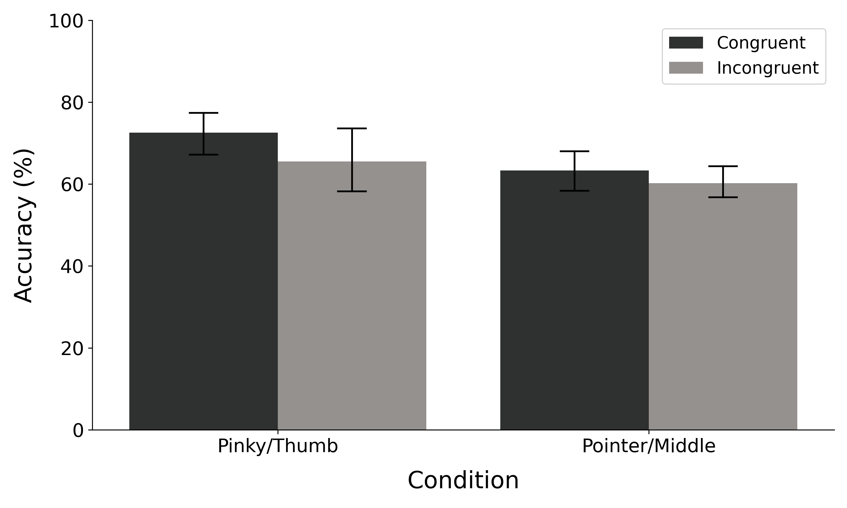
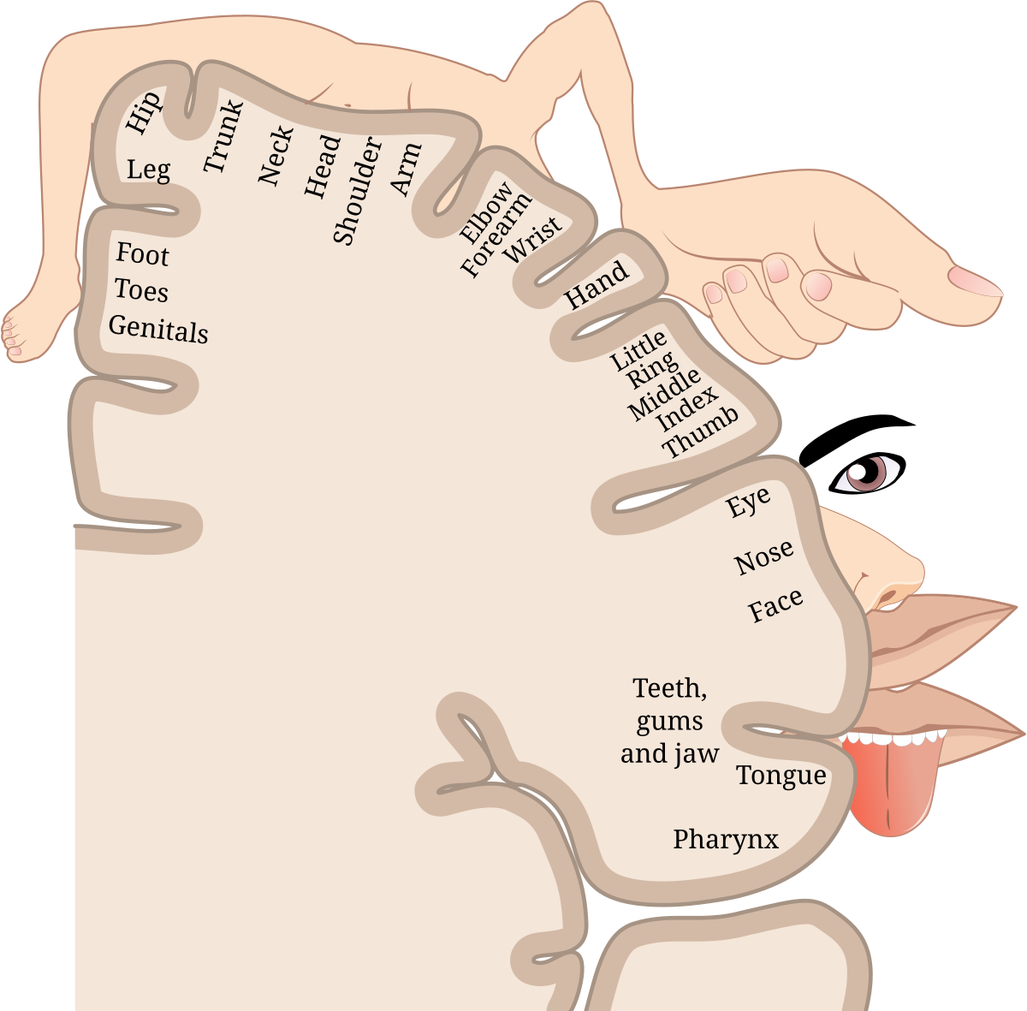
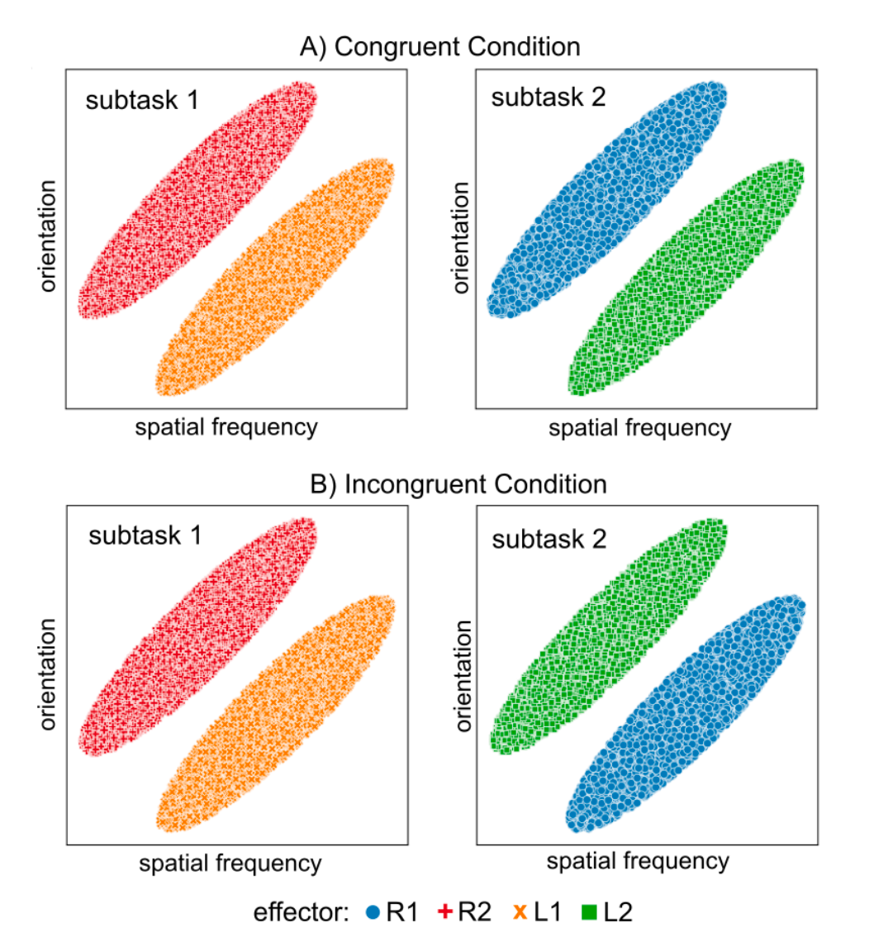
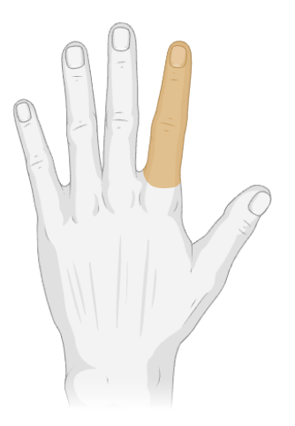
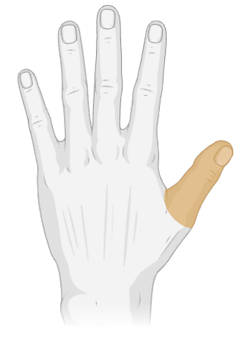
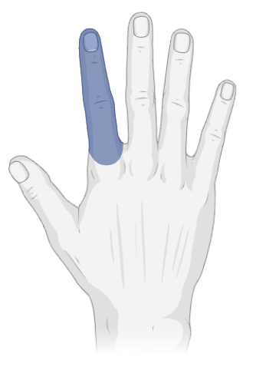
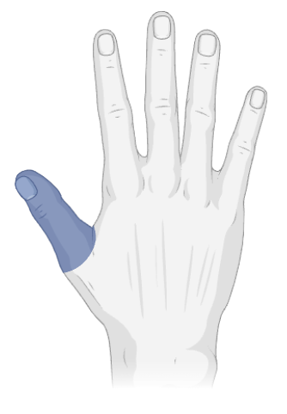
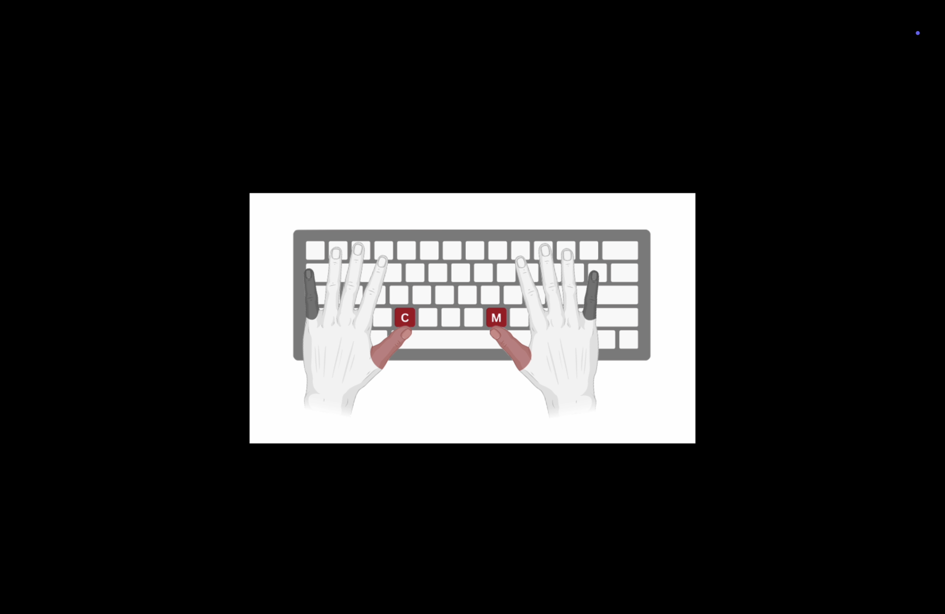
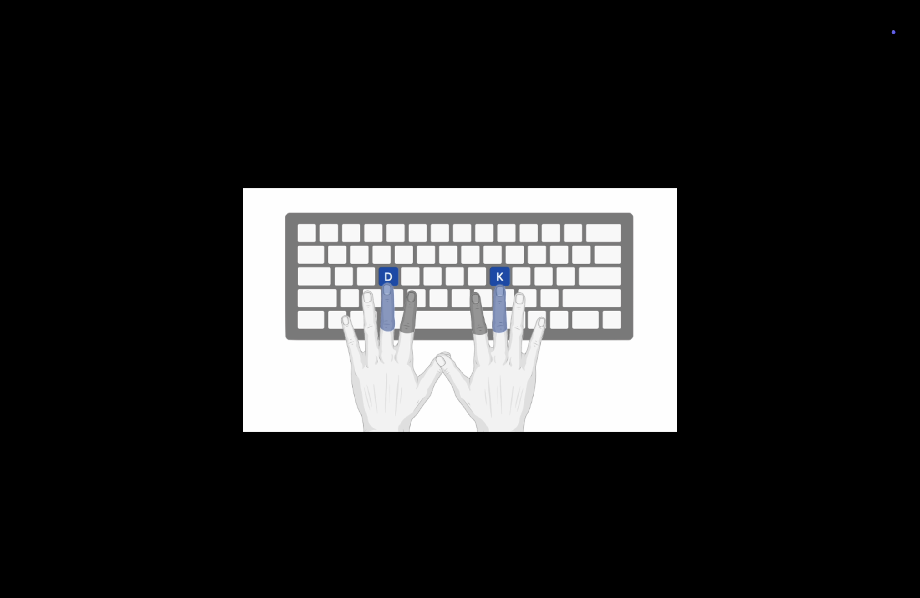
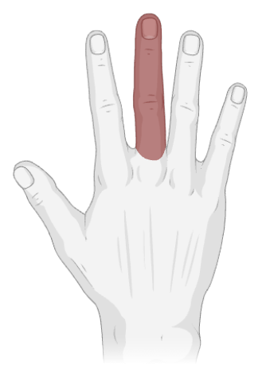
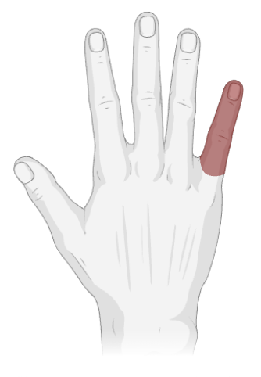
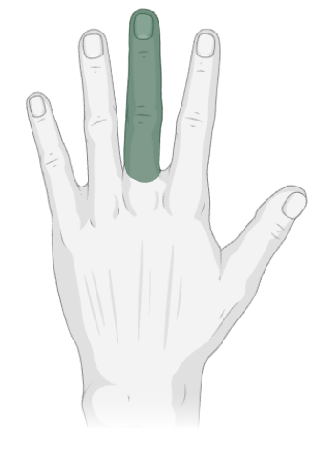
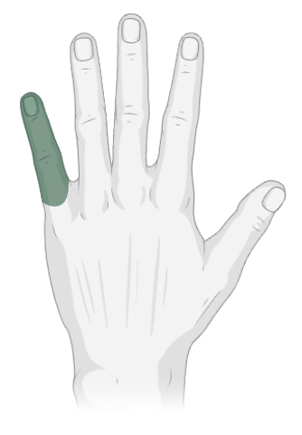


Category Learning during Task Switching
Kayla Rail¹, Saakshi Maneyalil² and Dr. Matthew Crossley²
¹ Faculty of Medicine and Health Sciences, Macquarie University, Sydney, Australia. ² School of Psychological Sciences.
INTRODUCTION
Category learning can have serious consequences (e.g. Is this berry poisonous?)
Procedural category learning is where categorisation responses are learned using trial-and-error feedback¹
Prior research has demonstrated that performance was impaired when the locations of the response keys were switched²⁻⁴
This suggests that associations are linked to motor goals (e.g., pressing a key on the right) compared to motor effectors (e.g., pressing with a specific finger)
It is unclear whether task-switching impairs how these associations are formed
RESULTS
Sample Text Column 1
AIMS
Examine whether task switching during a procedural category learning task is driven by the formation of associations between:
Stimuli and abstract motor goals (e.g., pressing a key) or
Stimuli and concrete motor actions (e.g., pressing with a specific finger)
Results
METHODS
Sample Text Column 1w
Congruent Condition
+
Subtask 1
=
Subtask 2
Pinky - Thumb
Index - Middle
Orientation
Orientation
Cue Image
DISCUSSION
Could only collect data once a week due to sharing the lab with other students
Spatial Frequency
Incongruent Condition
Spatial Frequency
Subtask 1
=
Subtask 2
Stimulus
Orientation
Orientation
Feedback
CONCLUSIONS
Findings
Sample Text Column 1
Spatial Frequency
Spatial Frequency
R2
L2
Cue Image
REFERENCES
Ashby FG, Valentin VV. Multiple Systems of Perceptual Category Learning: Theory and Cognitive Tests. Elsevier; 2005. p. 547–72.
Ashby FG, Ell SW, Waldron EM. Procedural learning in perceptual categorization. Mem Cognit. 2003 Oct;31(7):1114–25.
Crossley MJ, Madsen NR, Ashby FG. Procedural learning of unstructured categories. Psychon Bull Rev. 2012 Dec;19(6):1202–9.
Spiering BJ, Ashby FG. Response processes in information–integration category learning. Neurobiol Learn Mem. 2008 Sep;90(2):330–8.
L1
R1
Notes:
Explanation of predictions >> need to explain the difference between index/middle // pinky/thumb

Slide 3
Category Learning during Task Switching
Kayla Rail¹, Saakshi Maneyalil² and Dr. Matthew Crossley²
¹ Faculty of Medicine and Health Sciences, Macquarie University, Sydney, Australia. ² School of Psychological Sciences.
INTRODUCTION
Category learning can have serious consequences (e.g. Is this berry poisonous?)
Procedural category learning is where categorisation responses are learned using trial-and-error feedback¹
Prior research has demonstrated that performance was impaired when the locations of the response keys were switched²⁻⁴
This suggests that associations are linked to motor goals (e.g., pressing a key on the right) compared to motor effectors (e.g., pressing with a specific finger)
It is unclear whether task-switching impairs how these associations are formed
RESULTS
- Add homunculus image to help explanation
Sample Text Column 1
AIMS
Examine whether task switching during a procedural category learning task is driven by the formation of associations between:
Stimuli and abstract motor goals (e.g., pressing a key) or
Stimuli and concrete motor actions (e.g., pressing with a specific finger)
R2
L2
Sample Text Column 1w
L1
R1
=
Congruent Condition
Subtask 1
Subtask 2
Cue Image
DISCUSSION
Could only collect data once a week due to sharing the lab with other students
Orientation
Orientation
Stimulus
=
Spatial Frequency
Incongruent Condition
Spatial Frequency
Subtask 1
Subtask 2
Orientation
CONCLUSIONS
Findings
Sample Text Column 1
Feedback
Orientation
Spatial Frequency
Spatial Frequency
Cue Image
REFERENCES
Ashby FG, Valentin VV. Multiple Systems of Perceptual Category Learning: Theory and Cognitive Tests. Elsevier; 2005. p. 547–72.
Ashby FG, Ell SW, Waldron EM. Procedural learning in perceptual categorization. Mem Cognit. 2003 Oct;31(7):1114–25.
Crossley MJ, Madsen NR, Ashby FG. Procedural learning of unstructured categories. Psychon Bull Rev. 2012 Dec;19(6):1202–9.
Spiering BJ, Ashby FG. Response processes in information–integration category learning. Neurobiol Learn Mem. 2008 Sep;90(2):330–8.
Notes:
Explanation of predictions >> need to explain the difference between index/middle // pinky/thumb

Slide 4
Category Learning during Task Switching
Kayla Rail¹, Saakshi Maneyalil² and Dr. Matthew Crossley²
¹ Faculty of Medicine and Health Sciences, Macquarie University, Sydney, Australia. ² School of Psychological Sciences.
INTRODUCTION
Category learning can have serious consequences (e.g. Is this berry poisonous?)
Procedural category learning is where categorisation responses are learned using trial-and-error feedback¹
Prior research has demonstrated that performance was impaired when the locations of the response keys were switched²⁻⁴
This suggests that associations are linked to motor goals (e.g., pressing a key on the right) compared to motor effectors (e.g., pressing with a specific finger)
It is unclear whether task-switching impairs how these associations are formed
RESULTS
Sample Text Column 1
AIMS
Examine whether task switching during a procedural category learning task is driven by the formation of associations between:
Stimuli and abstract motor goals (e.g., pressing a key) or
Stimuli and concrete motor actions (e.g., pressing with a specific finger)
METHODS
Sample Text Column 1w
Congruent Condition
+
Subtask 1
=
Subtask 2
Pinky - Thumb
Index - Middle
Orientation
Orientation
Cue Image
DISCUSSION
Limitation: Could only collect data once a week due to sharing the lab with other students
Limitation: Small data set size, limited power!!!
Spatial Frequency
Incongruent Condition
Spatial Frequency
Subtask 1
=
Subtask 2
Stimulus
Orientation
Orientation
Feedback
CONCLUSIONS
Findings
Sample Text Column 1
Spatial Frequency
Spatial Frequency
R1
R2
Cue Image
REFERENCES
Ashby FG, Valentin VV. Multiple Systems of Perceptual Category Learning: Theory and Cognitive Tests. Elsevier; 2005. p. 547–72.
Ashby FG, Ell SW, Waldron EM. Procedural learning in perceptual categorization. Mem Cognit. 2003 Oct;31(7):1114–25.
Crossley MJ, Madsen NR, Ashby FG. Procedural learning of unstructured categories. Psychon Bull Rev. 2012 Dec;19(6):1202–9.
Spiering BJ, Ashby FG. Response processes in information–integration category learning. Neurobiol Learn Mem. 2008 Sep;90(2):330–8.
L1
L2

Slide 5
In the methods section, to show sufficient evidence of research, just mention that I also did a literature review but for the sake of time, it will not be covered in this presentation
REFERENCES
Ashby FG, Valentin VV. Multiple Systems of Perceptual Category Learning: Theory and Cognitive Tests. Elsevier; 2005. p. 547–72.
Ashby FG, Ell SW, Waldron EM. Procedural learning in perceptual categorization. Mem Cognit. 2003 Oct;31(7):1114–25.
Crossley MJ, Madsen NR, Ashby FG. Procedural learning of unstructured categories. Psychon Bull Rev. 2012 Dec;19(6):1202–9.
Spiering BJ, Ashby FG. Response processes in information–integration category learning. Neurobiol Learn Mem. 2008 Sep;90(2):330–8.

Slide 6
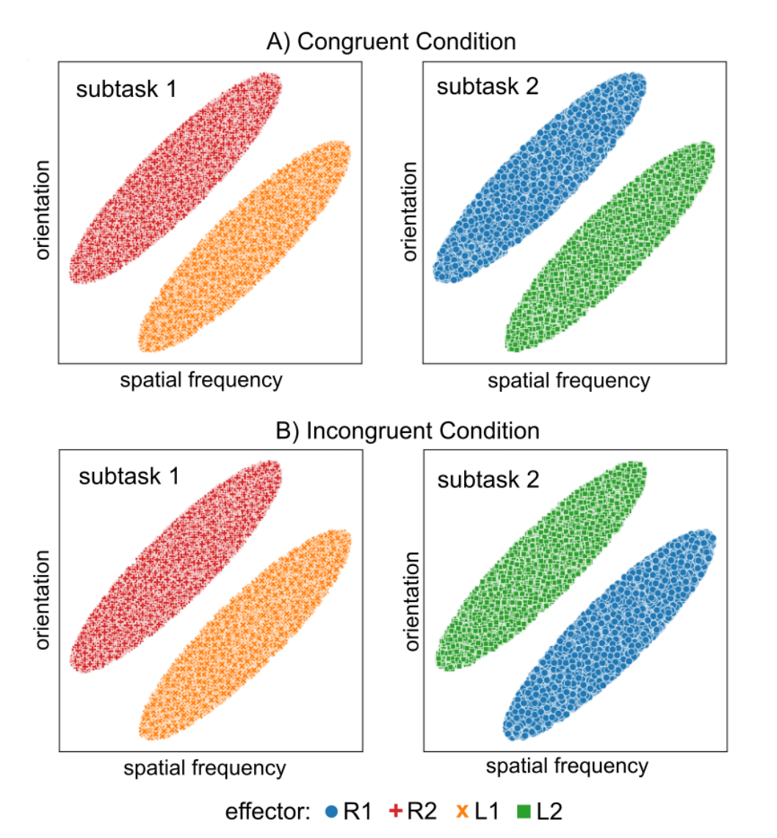
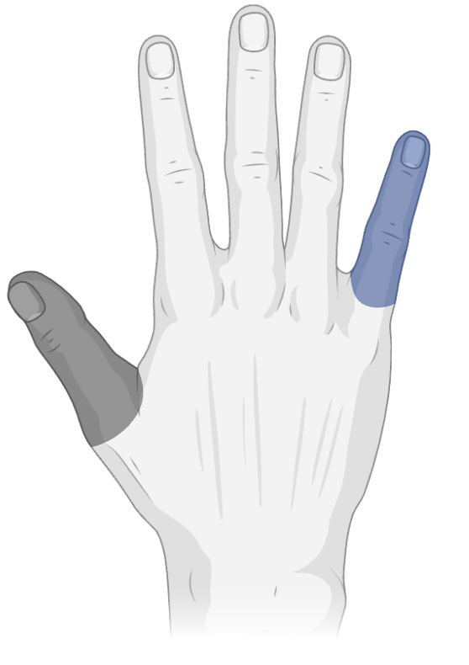
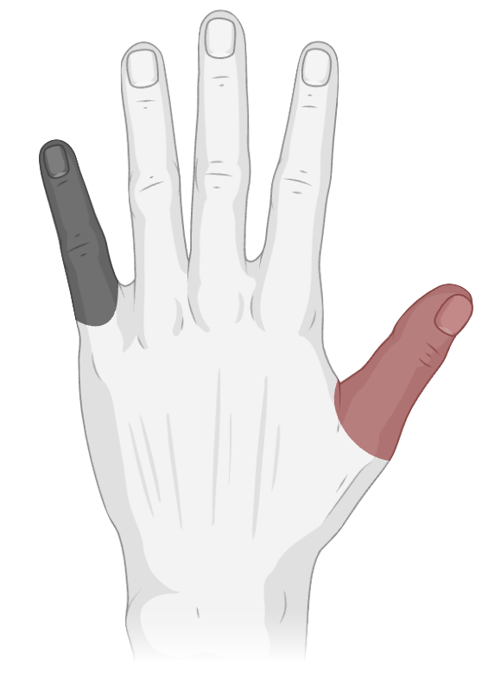
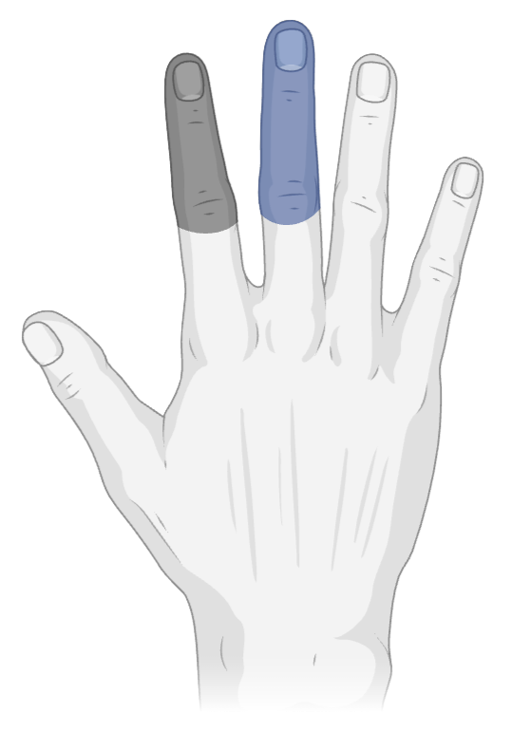
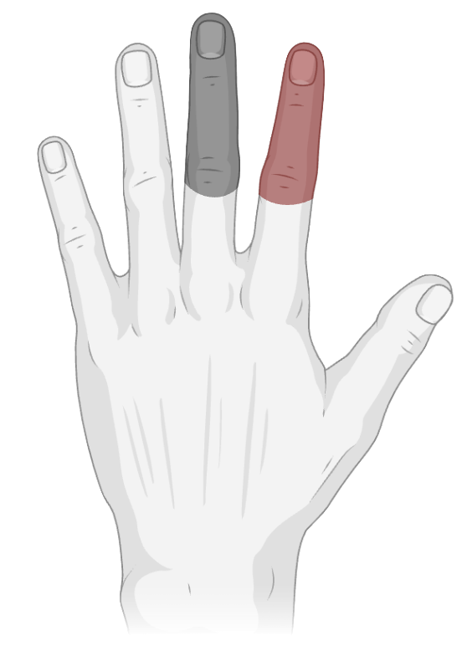
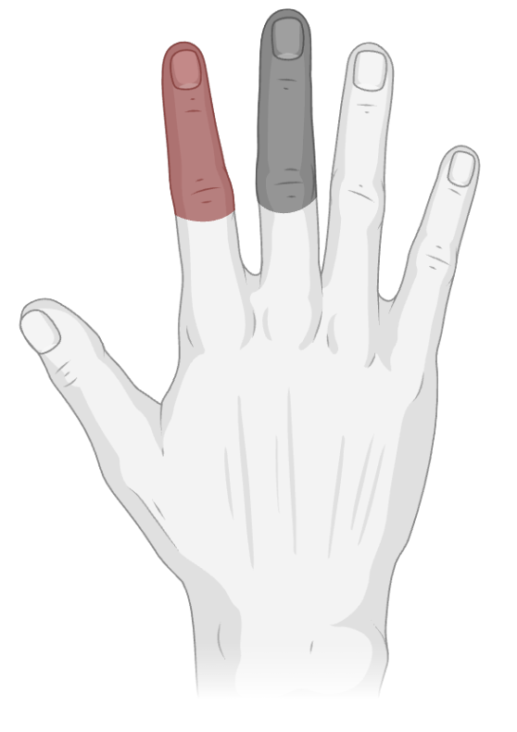
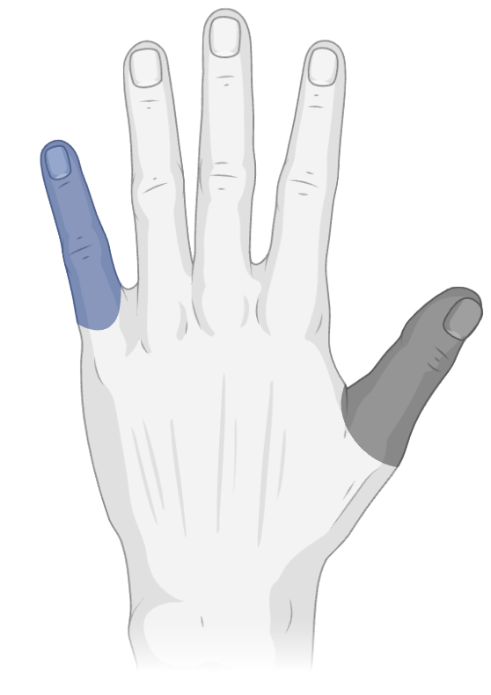
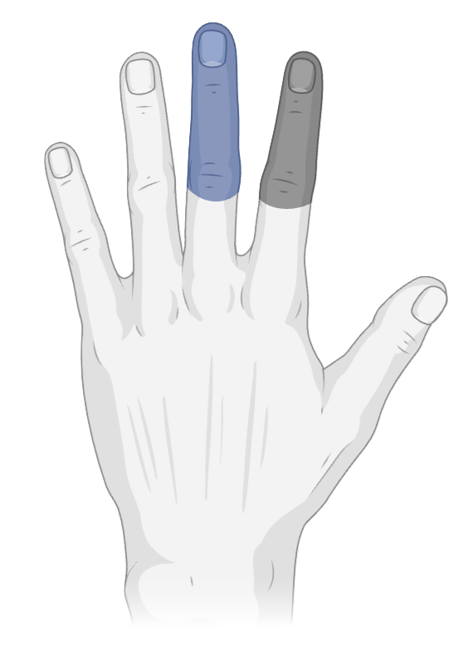
Right hand:
R1 = index
R2 = middle
R1 = thumb
R2 = pinkie
Left hand:
L1 = index
L2 = middle
L1 = thumb
L2 = pinkie
=
=

